Slide 1

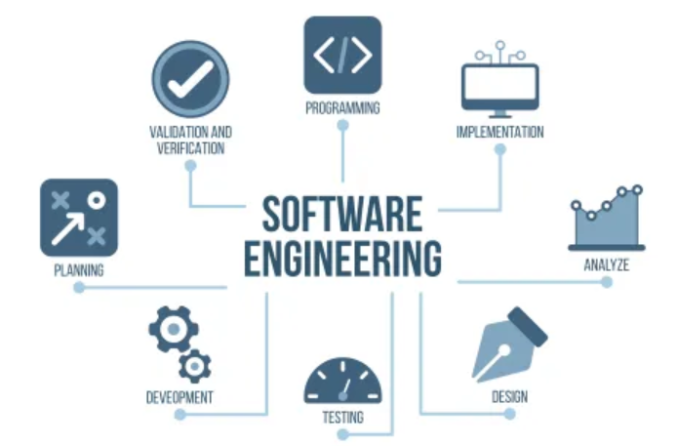
Computer Engineering and Application
AGILE SOFTWARE DEVELOPMENT

Slide 2


Slide 3


Slide 4
INTRODUCTION
Agile Software Development is an iterative and incremental approach to developing a software that emphasizes the importance of delivering a working product quickly and frequently. It involves close collaboration between the development team and the customer to ensure that the product meets their needs and expectations.

Slide 5
TRADITIONAL VS AGILE METHOD
Project Structure:
Traditional Method (Waterfall Model):
Linear and Sequential: Projects follow a fixed sequence of phases: requirements gathering, design, implementation, testing, deployment, and maintenance.
Phases are fixed: Once a phase is completed, it's difficult to go back and make changes.
Agile Method:
Iterative and Incremental: Projects are broken down into smaller cycles called iterations or sprints. Each sprint delivers a potentially shippable product increment.
Flexible: Changes can be made at any stage of the project, with the ability to revisit and refine previous work.

Slide 6
2. Project Planning:
Traditional Method:
Detailed Upfront Planning: Extensive planning is done at the beginning of the project, with a clear and detailed project plan.
Fixed Scope: The scope, timeline, and budget are usually set at the start and changes are typically avoided.
Agile Method:
Adaptive Planning: Planning is continuous and evolves throughout the project. Only the next few sprints are planned in detail.
Flexible Scope: The scope can change based on feedback and evolving needs. Priorities are adjusted as the project progresses.

Slide 7
3. Team Structure:
Traditional Method:
Hierarchical: Teams often have a clear hierarchy with project managers overseeing the work.
Specialized Roles: Team members typically have specialized roles (e.g., developers, testers).
Agile Method:
Collaborative: Teams are cross-functional and self-organizing, with members working together closely.
Generalized Roles: Team members often take on multiple roles, contributing to different aspects of the project.

Slide 8
4. Customer Involvement:
Traditional Method:
Limited: Customers are usually involved only at the beginning (requirements phase) and end (delivery phase).
Fixed Deliverables: The final product is delivered at the end of the project.
Agile Method:
High Involvement: Customers are continuously involved, providing feedback at the end of each sprint.
Incremental Deliverables: Working increments of the product are delivered regularly.

Slide 9
5. Risk Management:
Traditional Method:
  Higher Risk: Risks are often identified and mitigated during the planning phase. If requirements change, it can be difficult to adapt.
Agile Method:
  Lower Risk: Frequent feedback and incremental delivery help identify and address risks early, reducing the impact of changes.

Slide 10
MENIFESTO FOR AGILE SOFTWARE DEVELOPMENT
The Agile Manifesto is based on four key values:
1) Individuals and Interactions over Processes and Tools
Prioritizing communication and collaboration among team members rather than relying solely on processes and tools.
2) Working Software over Comprehensive Documentation
Delivering functional software is more important than producing extensive documentation. Documentation is important but should support the working software, not overwhelm it.
3) Customer Collaboration over Contract Negotiation
Engaging with customers throughout the project to ensure the product meets their needs, rather than just following a contract.
4) Responding to Change over Following a Plan
Embracing change, even late in the development process, rather than strictly adhering to a pre-defined plan.

Slide 11
12 PRINCIPLES OF AGILE
Customer Satisfaction: The highest priority is to satisfy the customer through early and continuous delivery of valuable software.
Welcome Changing Requirements: Agile processes harness change for the customer’s competitive advantage, even late in development.
Frequent Delivery: Deliver working software frequently, from a couple of weeks to a couple of months, with a preference for the shorter timescale.
Collaboration: Business people and developers must work together daily throughout the project.
Motivated Individuals: Build projects around motivated individuals. Give them the environment and support they need, and trust them to get the job done.

Slide 12
12 PRINCIPLES OF AGILE
Face-to-Face Conversation: The most efficient and effective method of conveying information to and within a development team is face-to-face conversation.
Working Software: Working software is the primary measure of progress.
Sustainable Development: Agile processes promote sustainable development. The sponsors, developers, and users should be able to maintain a constant pace indefinitely.
Technical Excellence: Continuous attention to technical excellence and good design enhances agility.

Slide 13
12 PRINCIPLES OF AGILE
Simplicity: The art of maximizing the amount of work not done—essentially, simplicity—is essential.
Self-Organizing Teams: The best architectures, requirements, and designs emerge from self-organizing teams.
Reflection and Adjustment: At regular intervals, the team reflects on how to become more effective, then tunes and adjusts its behavior accordingly.

Slide 14
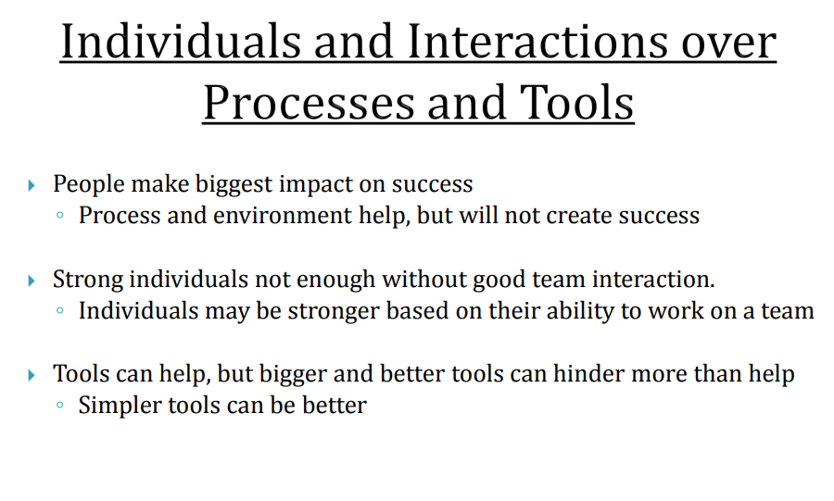

Slide 15
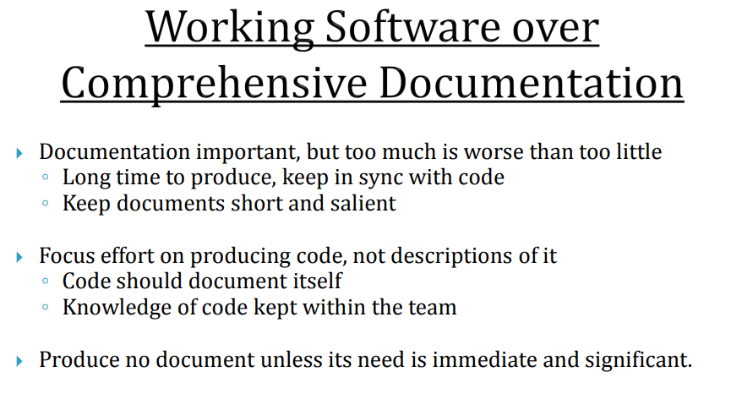

Slide 16
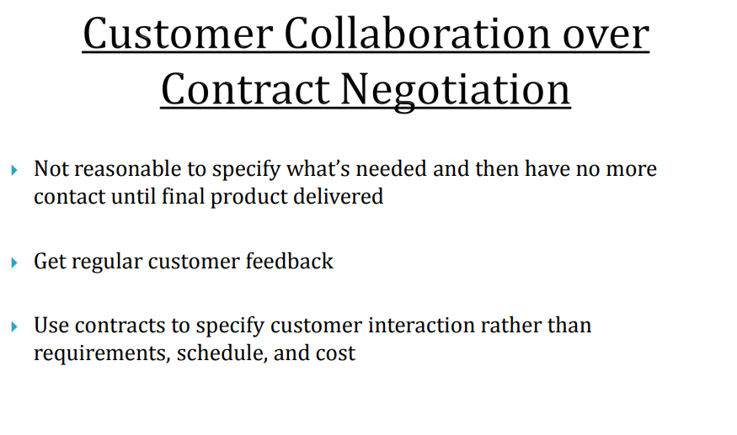

Slide 17
